Slide 1
Student Information System (SIS) Capstone project
Anupama Karumudi
Veekija Thirumalai

Slide 2
Agenda
Overview - SIS
Why SIS?
Technology details
SIS – Features
Administrator Modules
Teacher Modules
Student Modules
Public User Modules

Slide 3
Overview – SIS
SIS is

Slide 4
SIS – Use Case Model
Update prospective student’s page
View attendance
Update attendance
View all new applications
View progress
Update Application
Update progress
View grades
Update admission status
Update grades
Enroll new students
Set objectives to IEP student
Create class and schedules
Administrative User
Update IEP student progress
View teachers
View IEP student progress
Add teacher
View message center
Communicate with other users through the message center
Update teacher
View student records
Teacher
Update student records
Mobile Log In
Handle State reports
Mobile Log Out
View Ad-hoc reports
Mobile menu options screen
Log In
Mobile Message center
Log Out
Mobile view schedules
Update Profile
Mobile view score card
Access home page
Prospective students
Submit online applications
View attendance
View progress
Track applications status
Public User
Parent/Student
View grades

Slide 5
Why SIS?
SIS is

Slide 6
Technology Details
JSF & XHTML
XHTML facelets with JSF are used for page design, presentation and common form data validations.
Java Beans
Managed Java beans are used within JSF pages for data binding.
JPA
Java Persistence API (JPA) is used to simplify persisting objects to the database.
Rich faces
Richfaces is used within JSF facelet for calendar controls and rich text editor.
Web Filters
Used Java Servlet’s Web Filter with URL patterns to protect secured pages.
CSS
JSF resources are used (CSS) to maintaining consistency throughout the site
Derby database
Derby database is used for storing and retrieving the quiz data and user profiles.

Slide 7
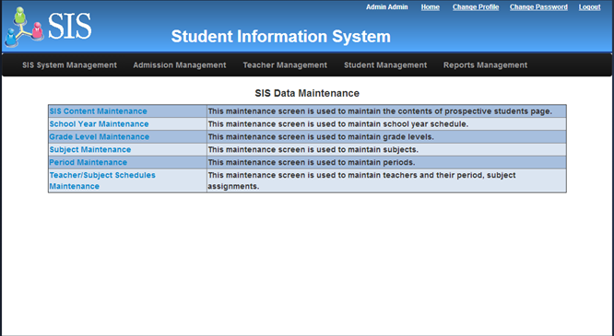
Administrator Modules
SIS System Management
Maintain to support school system data.

Slide 8
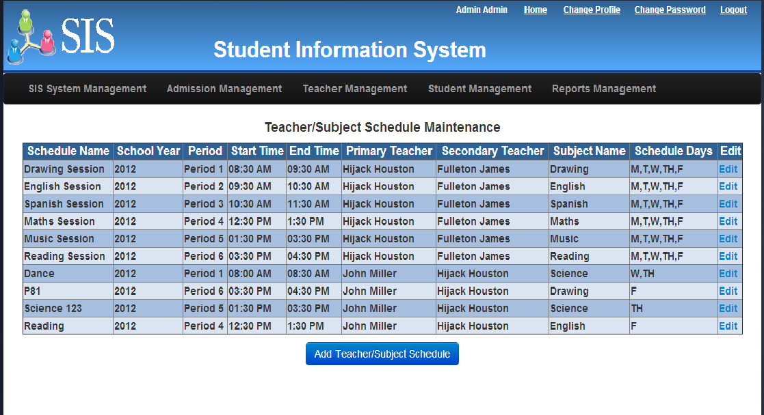
Administrator Modules – contd…
SIS System Management
Teacher/subject schedule maintenance

Slide 9
Administrator Modules – contd…
Admission Management
Edits submitted online application.
Creates new admission workflow.
Manages admission workflow process into various stages including:
Initial Review
Interview Requested
Approved
Rejected.

Slide 10
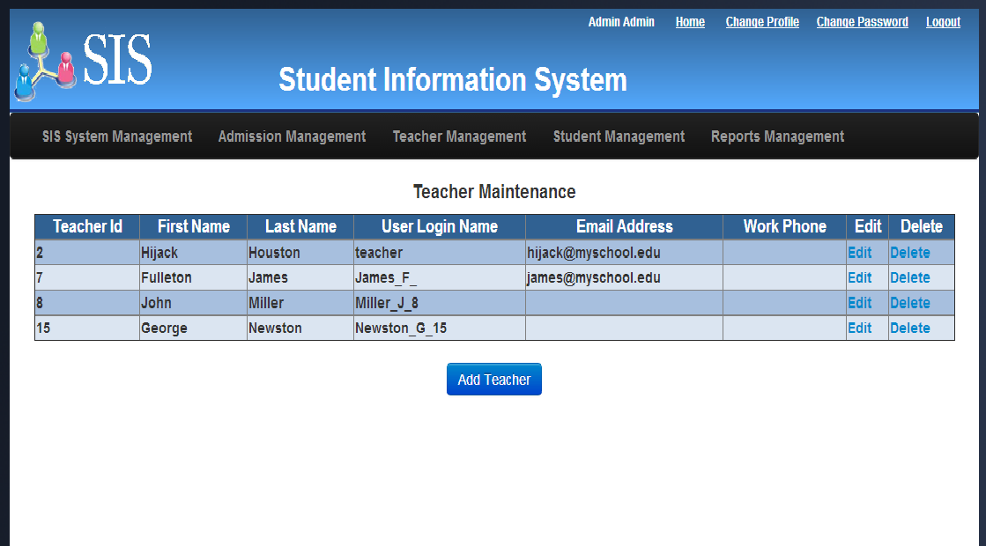
Administrator Modules – contd…
Teacher Management
Add and update teacher information.

Slide 11
Administrator Modules – contd…
Admission Management
Edits submitted online application.
Creates new admission workflow.
Manages admission workflow process into various stages including:
Initial Review
Interview Requested
Approved
Rejected.

Slide 12
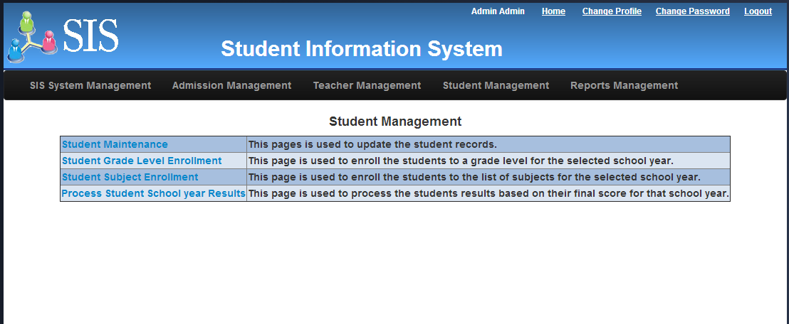
Administrator Modules – contd…
Student Management
Update student records.
Enroll students to Grade level
Enroll students to subjects
Process year end results.

Slide 13
Administrator Modules – contd…
Student Management - Enroll students to Grade level

Slide 14
Administrator Modules – contd…
Student Management - Enroll students to subjects

Slide 15
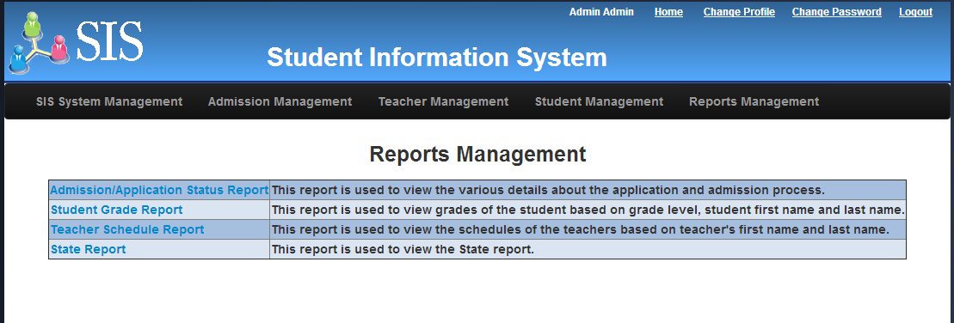
Administrator Modules – contd…
Report Management
Admission/Application Status report
Student Grade report
Teacher Schedule report
State report

Slide 16
Teacher Modules
SIS is

Slide 17
Student/Parent Modules
SIS is

Slide 18
Public User Modules
Prospective students
Track application status

Slide 19
Thank You

